Slide 1
Data Science: geoscience data + collection
PROFESSOR ALICIA KLEES
ATMS 517

Slide 2
geosciences data
Geosciences data includes data that is:
a record of a physical or descriptive characteristic of the earth system
a record of its inhabitants, that has a geographic
location associated with it.
Often, geosciences data will also have a time associated with it.
Geosciences data extends well beyond what we typically think of as “weather” or “climate” data.

Slide 3
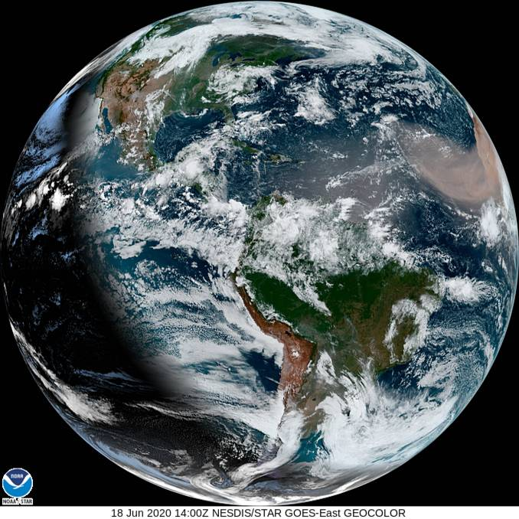
EXAMPLES OF GEOSCIENCES datA
Examples of geosciences data
weather stations
photos of glaciers
satellite imagery of earth
locations and times of earthquakes
surveys of tree populations in a forest
economic impact data from weather disasters
output from a weather forecast or climate model
surveys of human illness related to water quality
Image: GeoColor - True Color daytime, multispectral IR at night - 18 Jun 2020 - 1400 UTC. NOAA
Notes:
NOAA image URL: https://cdn.star.nesdis.noaa.gov/GOES16/ABI/FD/GEOCOLOR/20201701400_GOES16-ABI-FD-GEOCOLOR-678x678.jpg
Features dust moving westward off Africa.

Slide 4
forms of data
Geosciences data can take many forms
Digital: Data that is stored by a computer in binary format.
Analog: Data that is stored as a physical record.
What are examples of each of these?

Slide 5
Data collection methods, part 1 of 5
Data collection method: In situ
Definition: Measured directly by a sensor within the medium in its natural setting
Example: Thermometer
Advantages: Direct measurement can characterize instrument
Disadvantages: Only available where you have sensor(s)

Slide 6
Data collection methods, part 2 of 5
Data collection method: In vitro
Definition: Measured directly by a sensor within the medium outside its natural setting
Example: Aerosol filter brought back to lab
Advantages: Can collect and reanalyze
Disadvantages: Cumbersome?

Slide 7
Data collection methods, part 3 of 5
Data collection method: Computationally
Definition: Using a model to simulate and understand natural systems
Example: Climate model
Advantages: Computational power is cheap compared to observations
Disadvantages: “All models are wrong, but some are useful”

Slide 8
Data collection methods, part 4 of 5
Data collection method: By Proxy
Definition: Using one dataset to infer about another that cannot be directly measured (frequently used to reconstruct data that can not be observed)
Example: Measure tree rings to infer precipitation
Advantages: Can allow synthetic observations of past measurements
Disadvantages: Data not collected in a controlled setting/ relationship between proxy and variable?

Slide 9
Data collection methods, part 5 of 5
Data collection method: Remote Sensing
Definition: Using electromagnetic radiation to retrieve information
Example: Using infrared radiation to measure temperature
Advantages: Can often be applied over a large area
Disadvantages: Uncertain relationship between electromagnetic energy and variable

